Slide 1


WELCOME
Cybersecurity Clinic
Every business, cyber protected
Notes:
Hi, we are Cybersecurity Clinic providing B2B cybersecurity services to ensure that every business, regardless of their size or revenue, is cyber protected.

Slide 2

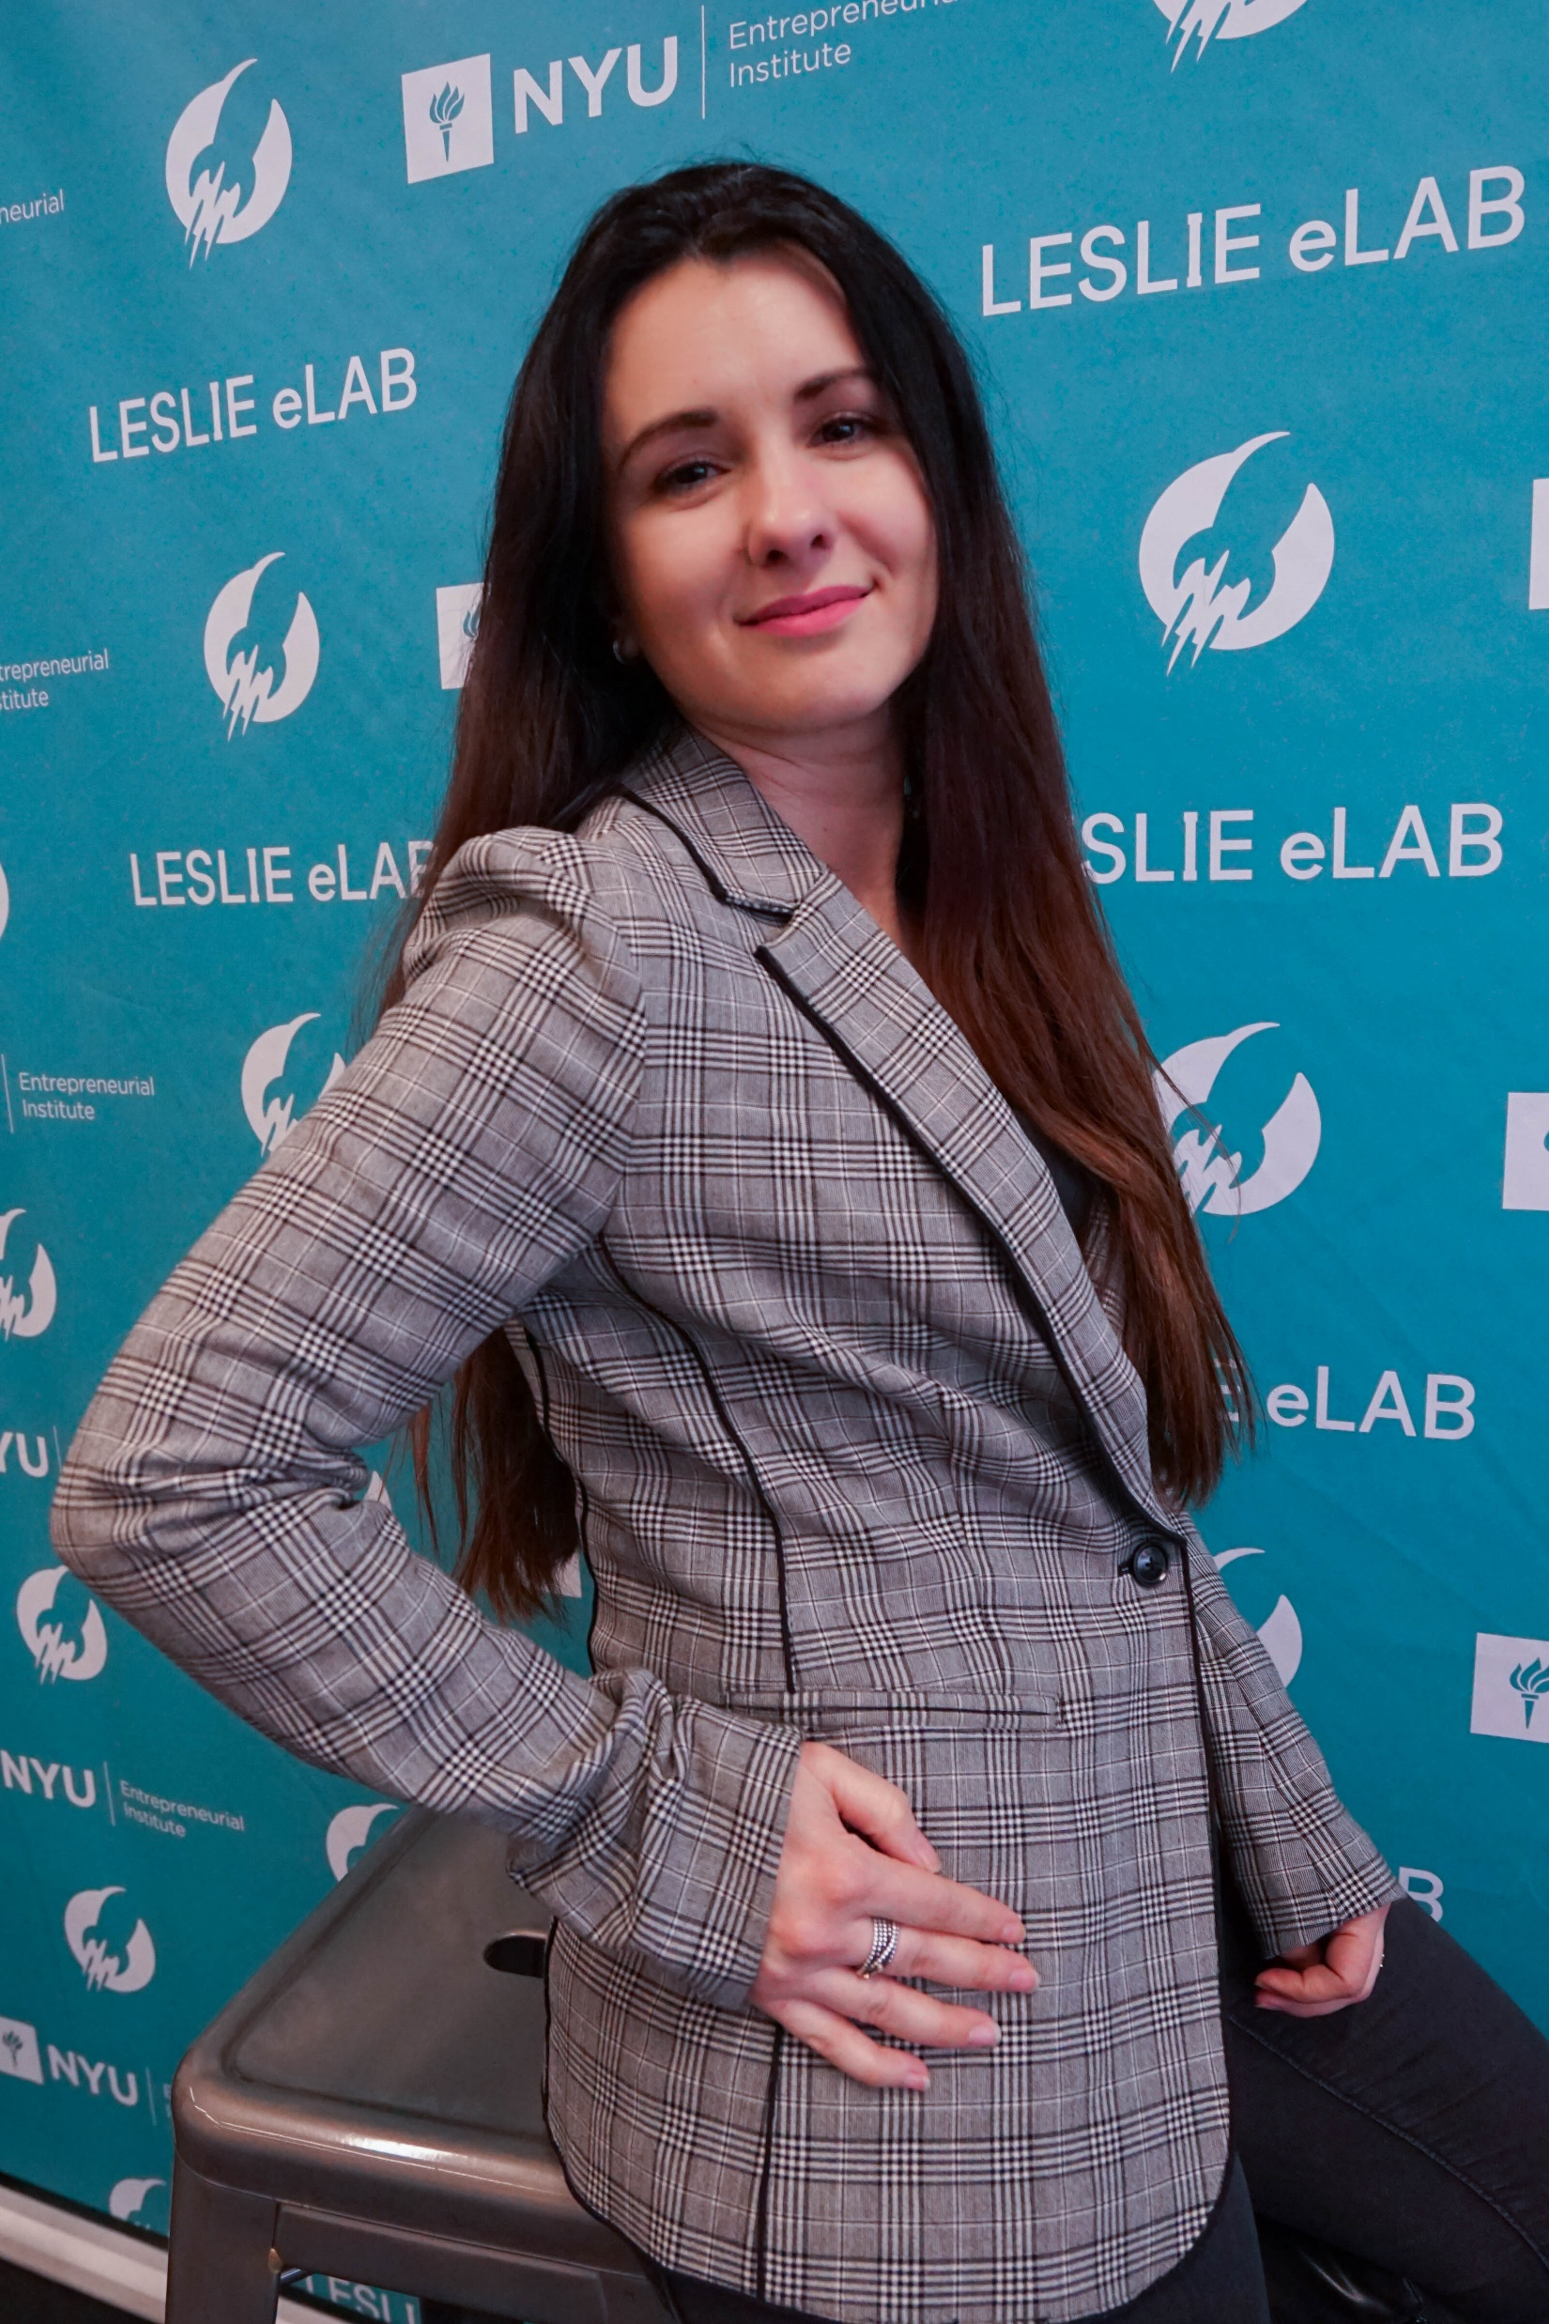


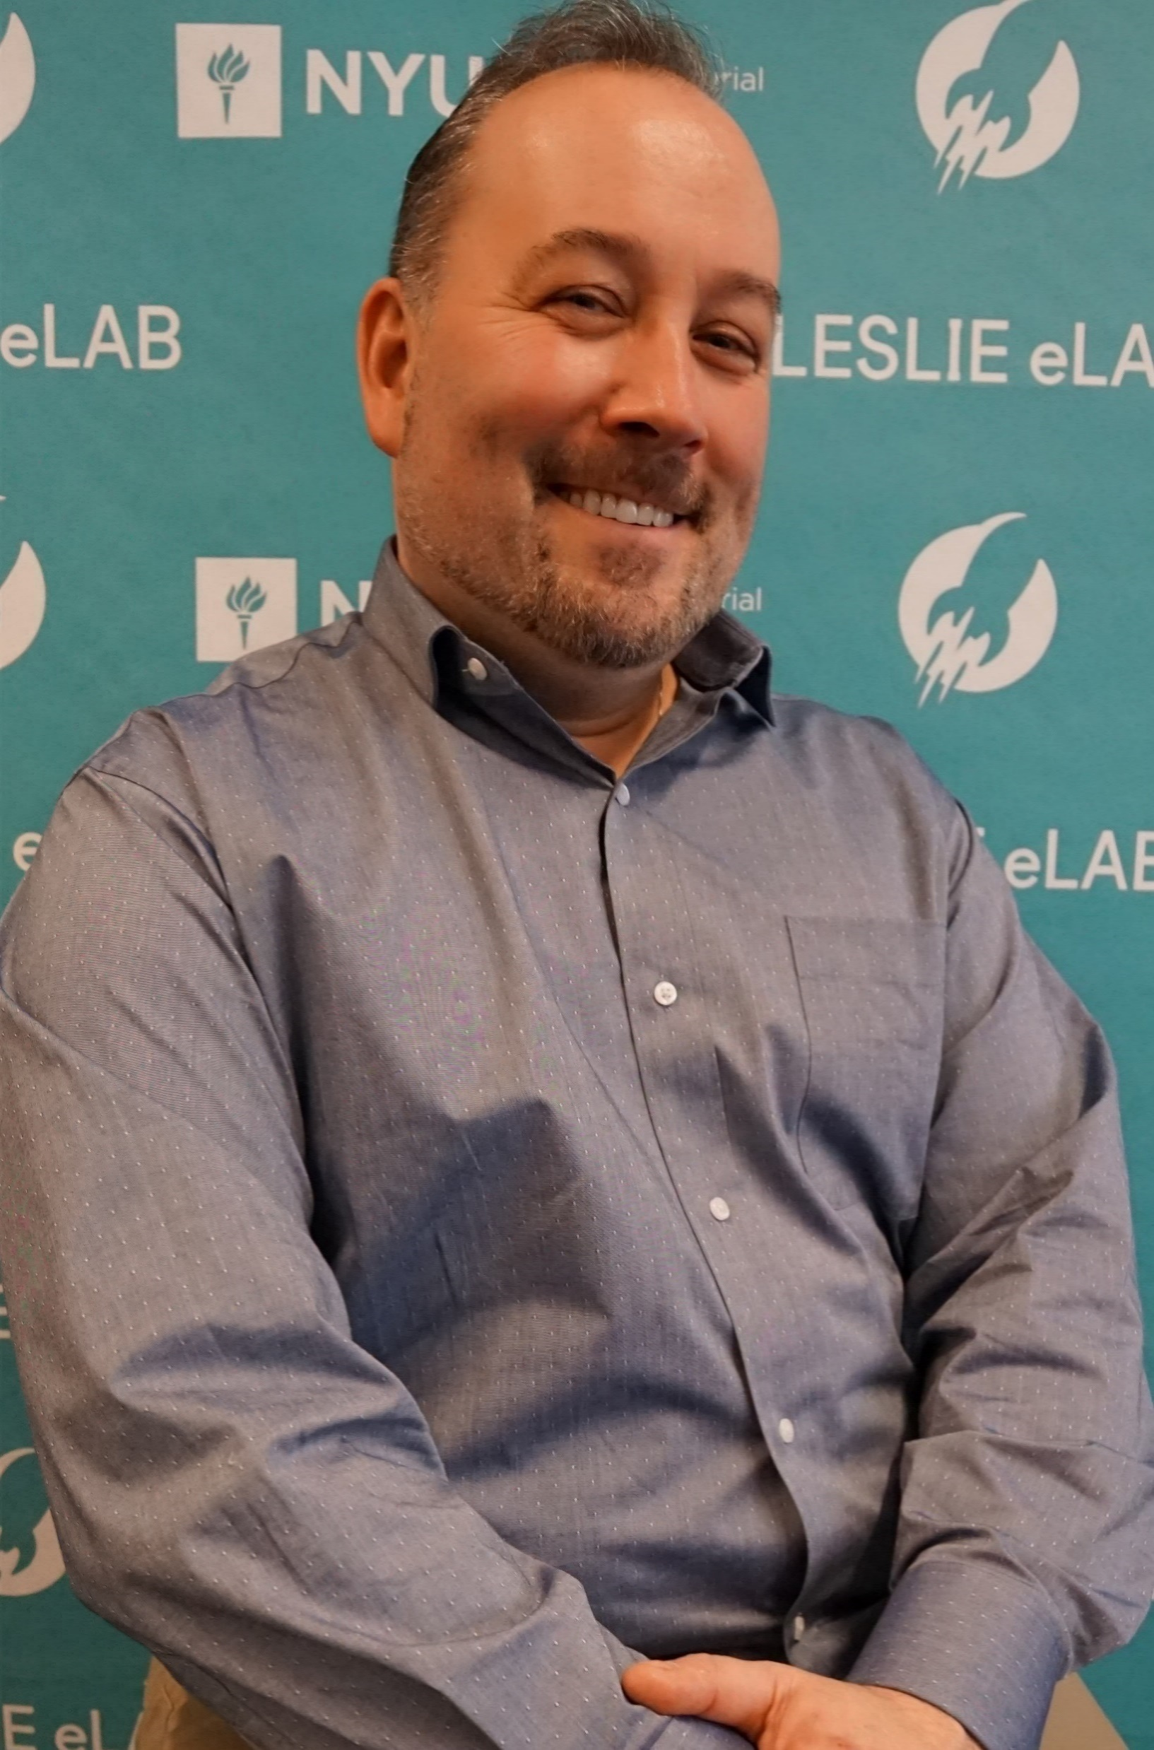
TEAM
Pa Thor, MSW
PhD Student
Research Analyst
Stanislava Hristova,
BS Marketing, CySA+
Marketing Director
Dan Weeks
Mentor
Cybersecurity Clinic
Lance Vang, CySA+
Software Engineer
Devon Foster, CySA+
Product Manager
Notes:
Our team consists of myself; I am an adjunct professor and graduate student at NYU. With my background as a social worker and researcher, I work as the Research Analyst. Stani is our marketing director and has over 7 years of professional experience. Lance is our Engineering Lead and has over 5 years of IT and software engineering experience. Devon is our Product Director and has over 20 years of experience managing educational and design companies. All three of my co-founders are also certified cybersecurity analysts
Lastly, our mentor, Dan Weeks, is professor at Cal Poly and has 25 years specializing in tech startups.

Slide 3
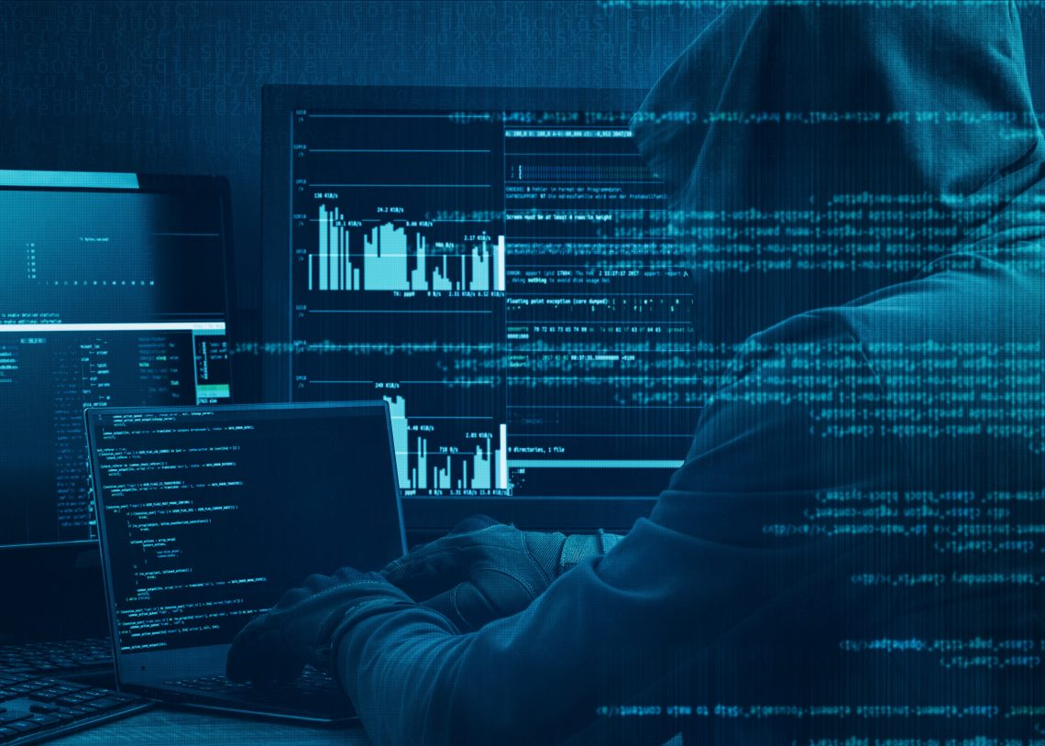




COST
PROBLEM
Data breaches cost $1 million+
Maximum penalty = $250K
SUSCEPTABILITY
Every 40 seconds a business falls victim to a ransomware attack.
43% of data breaches involves small businesses
EXISTING SITUATION
COVID-19
Increase business online
Notes:
Cost
Data breaches can cost businesses over $1 million
In NY, a business can also face a penalty of up to $250 for data breaches
Direct costs
Monetary theft
Remediation and system repair
Regulatory and compliance fines
Legal and public relations fees
Notification, identity theft repair and credit monitoring for affected parties
Increase in insurance premium
Indirect costs
Business disruption and downtime
Loss of business or customers
Loss of intellectual property
Damage to company credibility, brand and reputation
Susceptibility
Cyberattacks are the fastest growing crime in the U.S. and although data breaches of big companies (like Capitol One and Equifax) make headlines – an unprotected small business database is equally worth a hacker’s time.
Every 40 seconds a business falls victim to a ransomware attack and this is predicted to rise to every 14 seconds by 2019.
https://enterprise.verizon.com/resources/executivebriefs/2019-dbir-executive-brief.pdf
https://www.theglobeandmail.com/featured-reports/article-small-businesses-caught-in-an-epidemic-of-cyber-attacks/
https://www.vox.com/sponsored/11196054/why-every-small-business-should-care-about-cyber-attacks-in-5-charts
Existing situation
Since the very advent of the internet, Cyber-criminal have always been a threat, constantly finding new ways to steal our personal information, our finances, even our identities. Up until recently, only specific entities like financial, medical and educational organizations were required by law to protect our sensitive information. In recent years however, Europe, California and just last month, New York , with a proposed federal law currently making its way through congress, now require ALL organizations to implement a data protection plan. Failure to do so could invoke fines and legal action by Attorneys General.
https://techcrunch.com/2020/02/13/gilliband-law-data-agency/
As we all attempt to navigate this new world of viral pandemics by substituting on-line activity for in-person, the increased use of work-from-home, home schooling, on-line shopping and entertainment platforms all offer hackers new opportunities to exploit us. Information about economic relief programs, media streaming services, virtual meetings and remote classrooms are all targets now, and hackers all over the world are zeroing in.
https://www.marketwatch.com/story/zoom-microsoft-cloud-usage-are-rocketing-during-coronavirus-pandemic-new-data-show-2020-03-30
https://www.cbsnews.com/news/netflix-phishing-scam/
Cyber-attacks are on a dramatic rise and now more than ever, a cutting edge technical clinic is needed to provide awareness and cyber-triage.

Slide 4
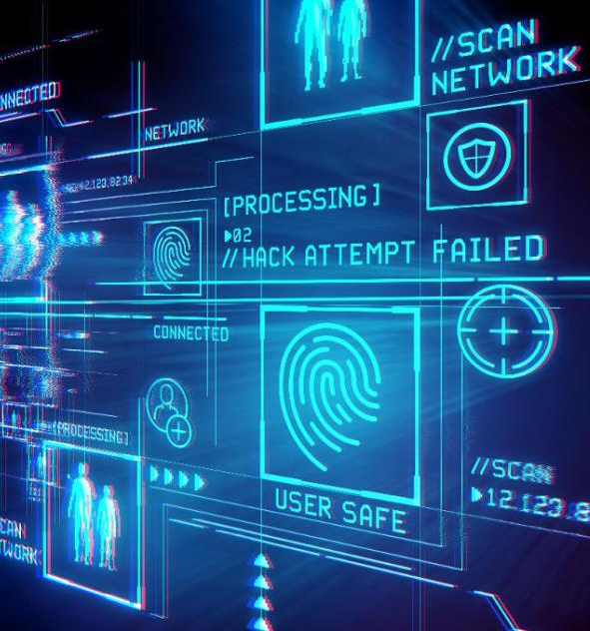
COST
SOLUTION
Preventative vs Remediation
Cost 5.6% of monthly IT spending
SUSCEPTABILITY
Best practices for cyber attacks, i.e. cyber security audit, develop security procedures
EXISTING SITUATION
Help businesses grow and adapt with changing times
Notes:
Cost
We are providing prevention services, which is easier and cheaper than remediation services.
Estimates of what companies should pay for cybersecurity services range from an additional 5.6% to 20% of the company's total IT spending. We aim for the lower end so, a company spending $3,000 per month to an IT managed service provider would pay around $168 per month for cybersecurity services – an attainable amount – and well worth it, given the potential cost of a cyberattack.
We help small businesses identify the highest-priority – and lowest-cost – items to tackle with their limited budget.
Susceptibility
To combat small businesses’ susceptibility, we aim to set them up with the best practices for protecting against cyber attacks. These can include a range of security services such as conducting an audit or working with them to develop security procedures.
Existing situation
We understand the current situation of the world and how this can potentially affect small businesses moving forward. We can tailor our cybersecurity company in the coming years to provide enhanced protection and help mitigate risks. We want to help business grow and adapt with peace of mind.
https://www.business.com/articles/smb-budget-for-cybersecurity/

Slide 5
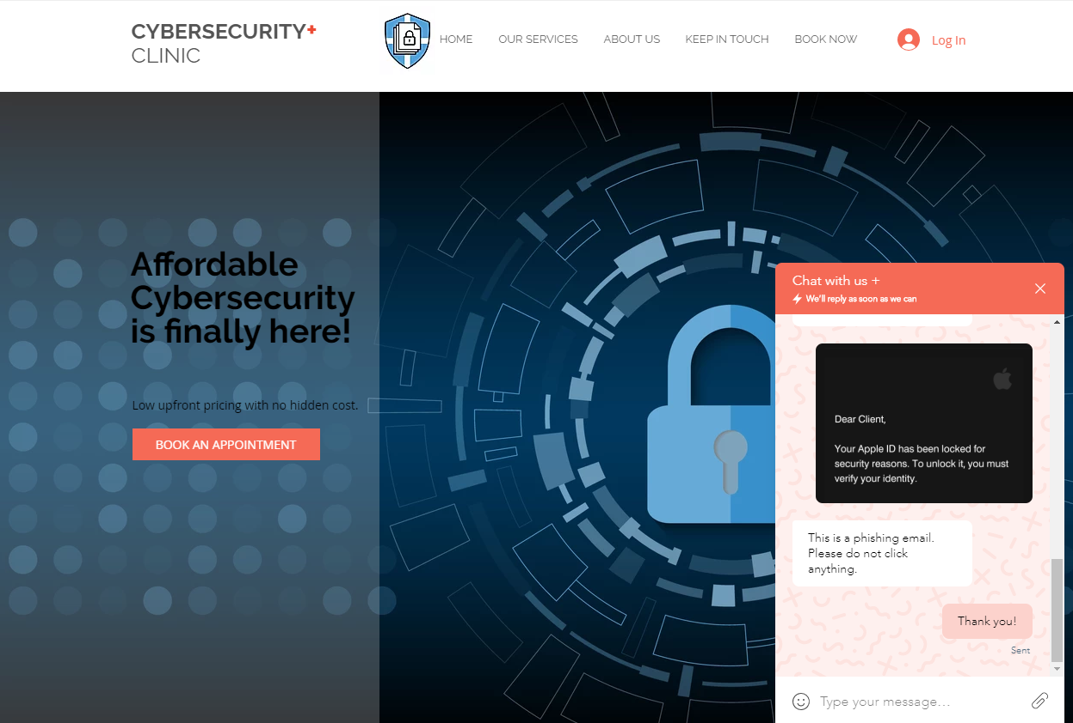



PRODUCT
#1
cybersecurityclinic.org
Chat service
Cybersecurity professionals
Notes:
Our company currently have 2 products that users can access from our website at cybersecurityclinic.org
We have a chat service where users can get assistance from a live cybersecurity professional.
They can do things such as submit a screenshot of an email and ask us to verify if it’s a phishing email or not.

Slide 6
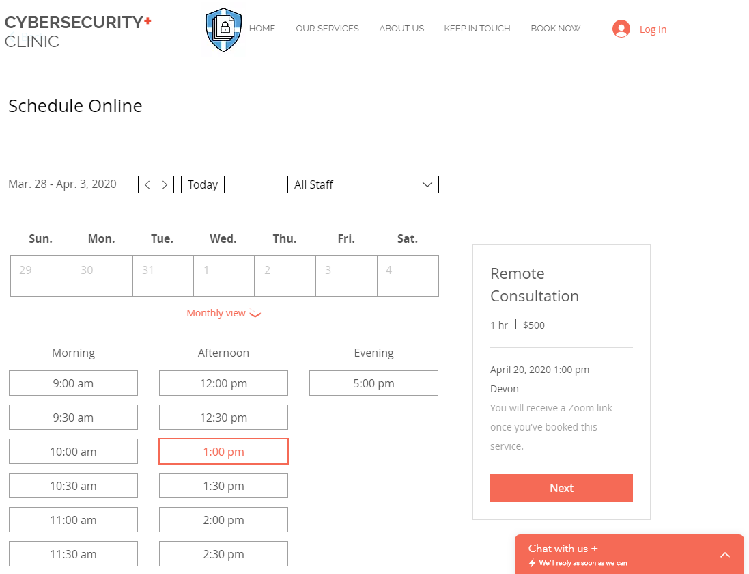



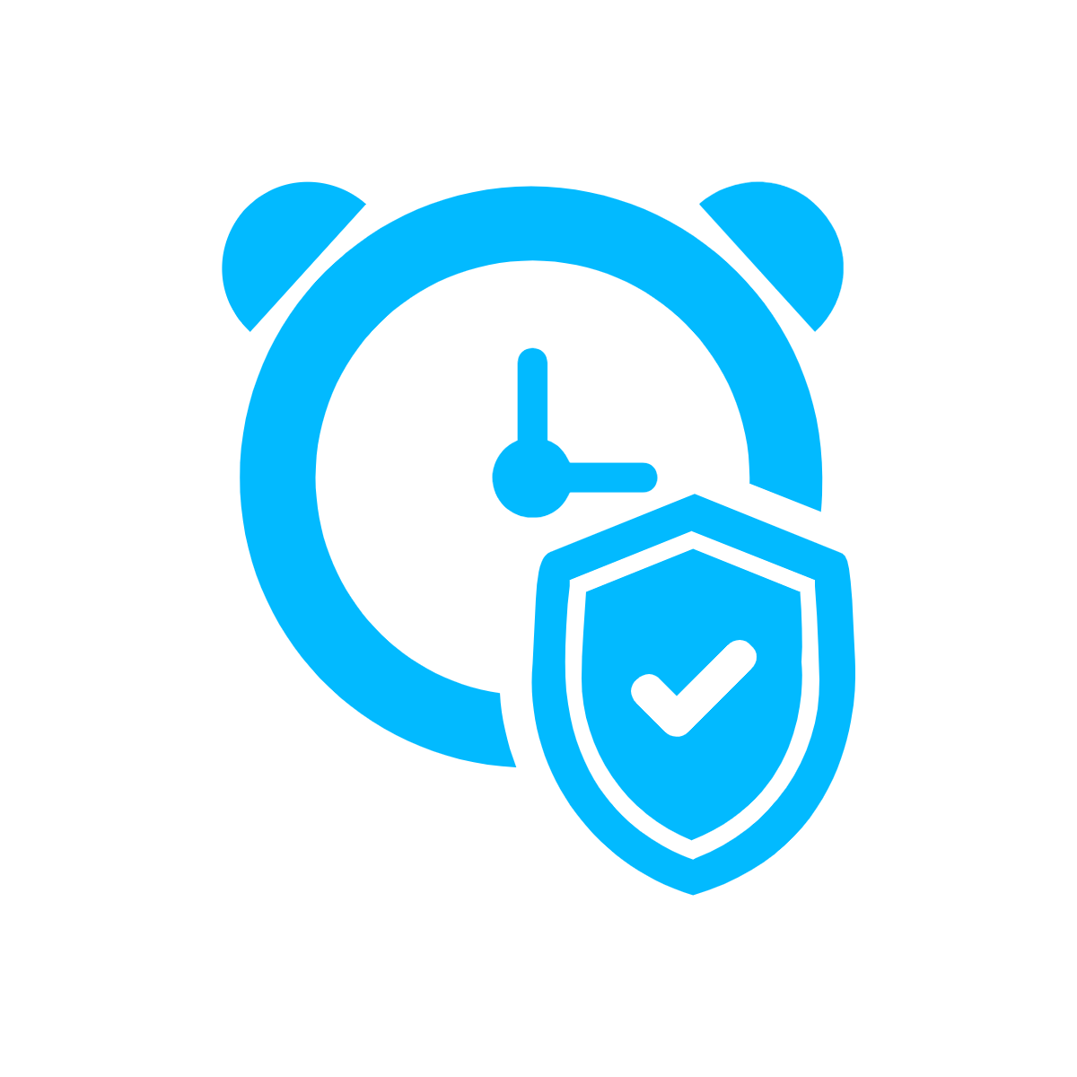
PRODUCT
#2
Remote consultation service
60 minutes
↓
protection against 85% of cyberattacks
Notes:
Our second product is a remote consultation service. Clients can book and pay for an appointment on our website and automatically receive a link for their appointed time.
Our consultation services focuses on cybersecurity prevention and after just 1 hour, we can prevent 85% of cyberattacks.

Slide 7

MARKET
SIZE
SB in the USA: 30.2 mil
SB in NY State: 2 mil
88% of SB owners face a vulnerability to cyberattacks
SB in NYC: 222,000
105,000 SB do not have a CS strategy
64% of SB have a website
Notes:
This is the breakdown of our market size: There are 30.2 million small businesses in the USA There are over 2 million small businesses in New York State and over 220,000 small businesses in NYC.
Among these small businesses, around 105 thousand SBs do not have a cybersecurity strategy. This is because 88% of small business owners (~193,600 in NYC) felt their business was vulnerable to a cyber attack and about 64% of SBs in NYC have a website, which can imply they conduct business online and can be vulnerable to data breaches.

Slide 8

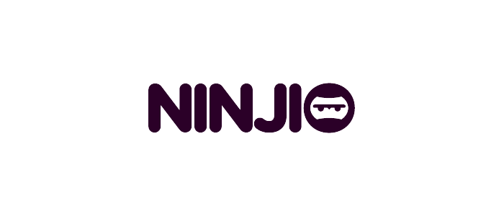
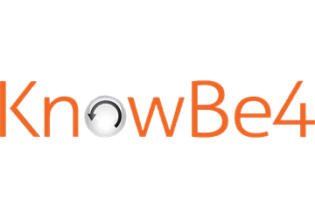
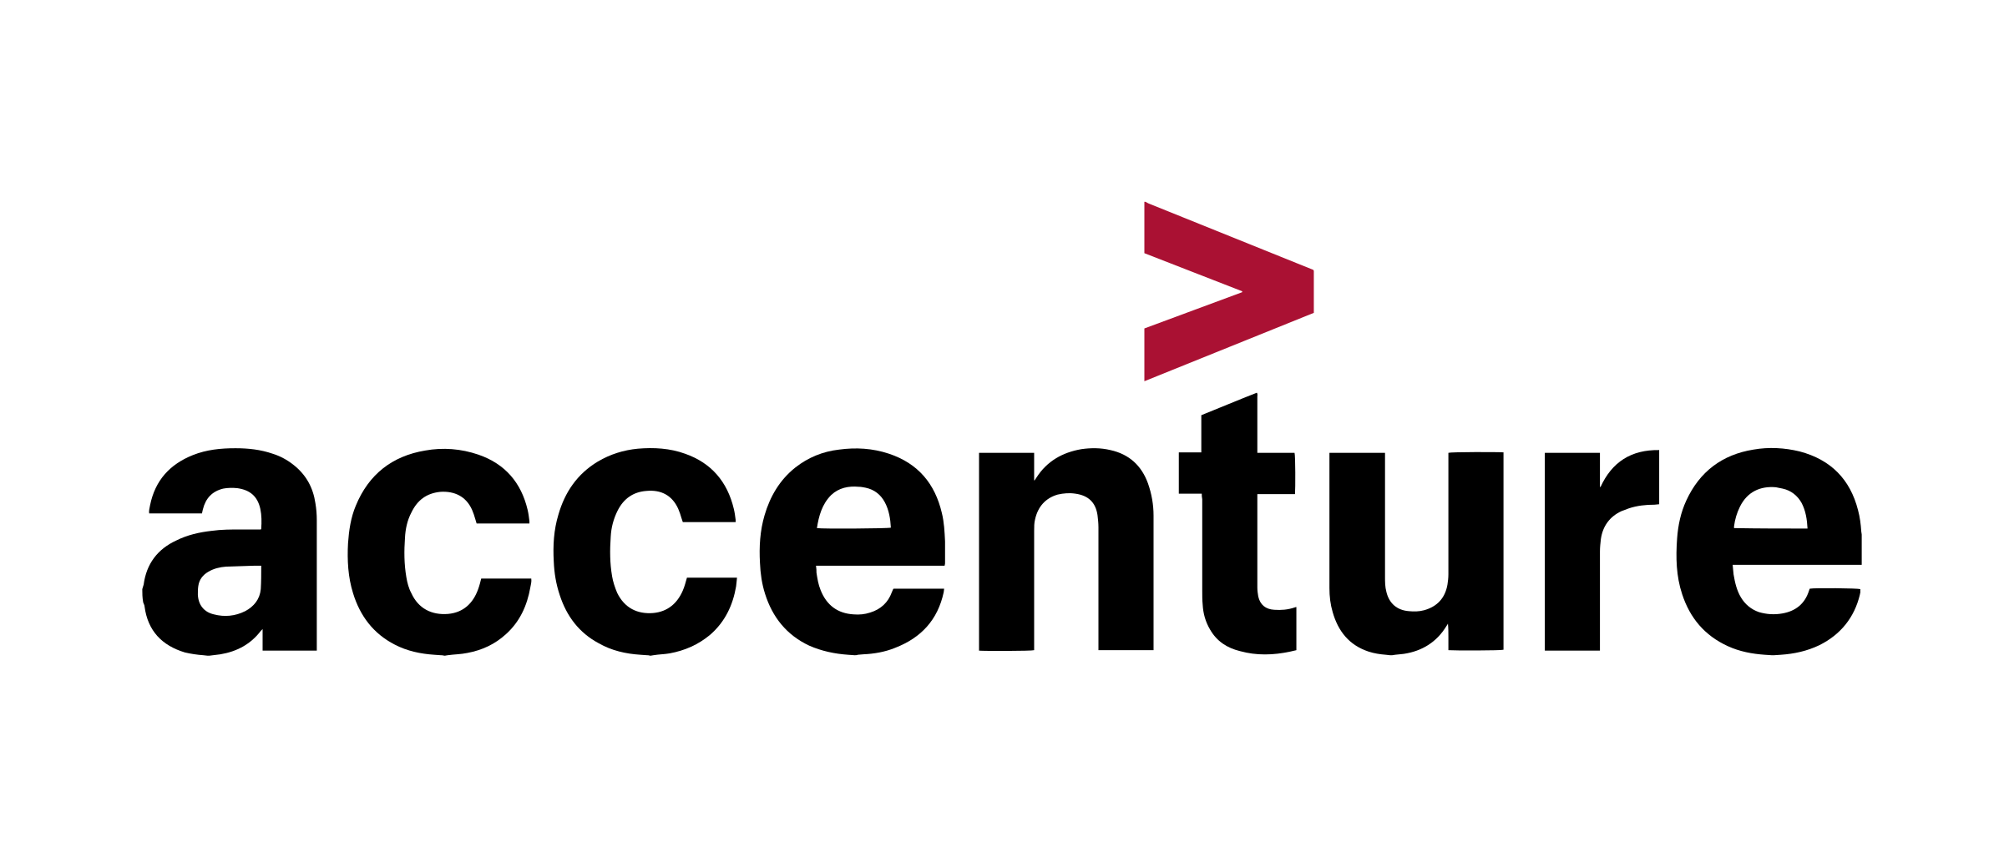

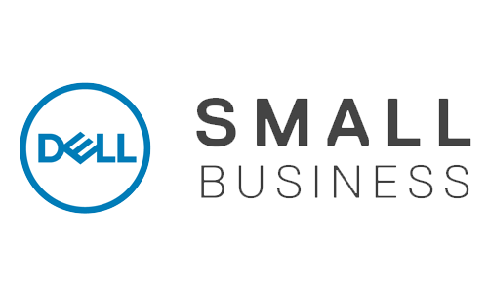


AFFORDABLE
COMPETITION
Cybersecurity Clinic
REMEDIATION
PREVENTION
EXPENSIVE
Notes:
Instead of focusing on prevention, a business’s approach to dealing with threats is reactive, focusing on the immediate threat.
X-axis: prevention/remediation
Y-axis: cost

Slide 9





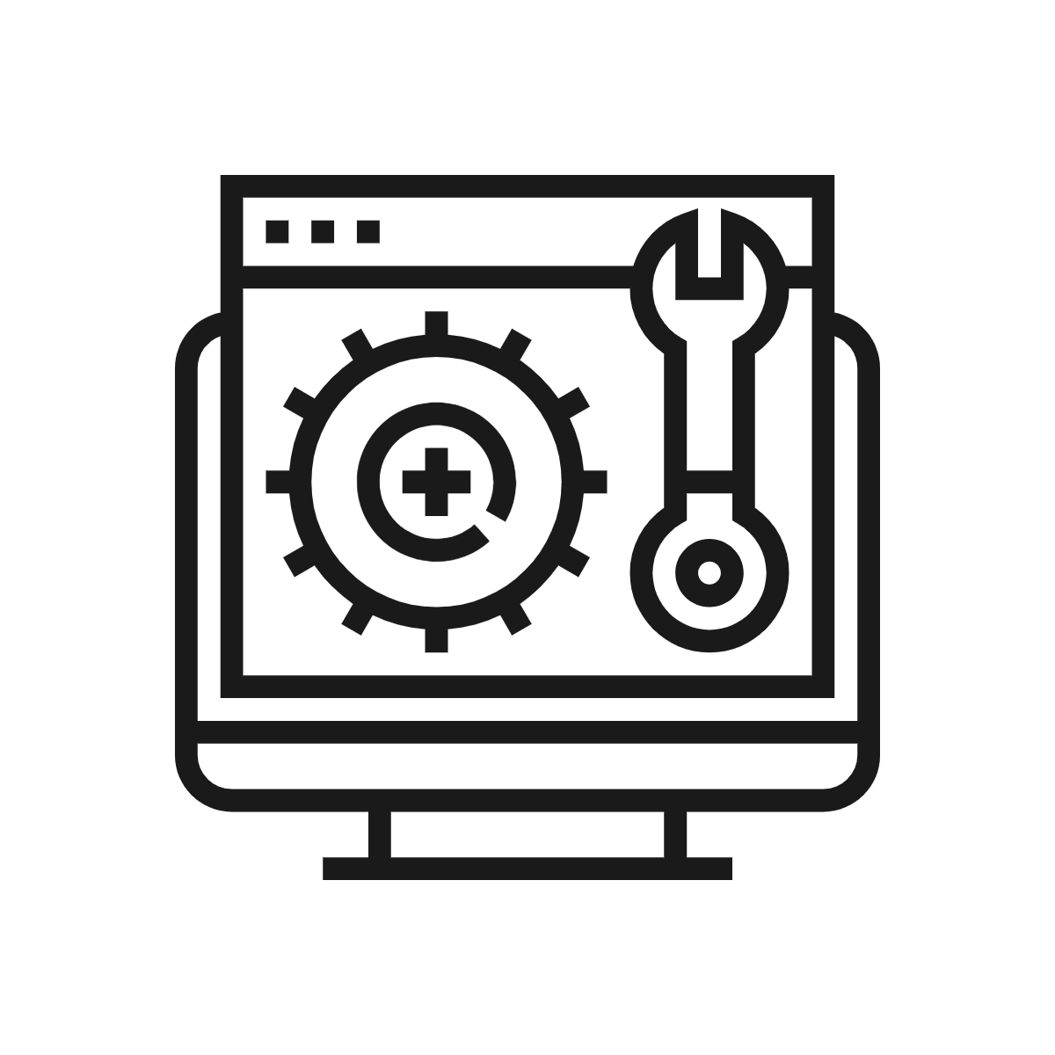

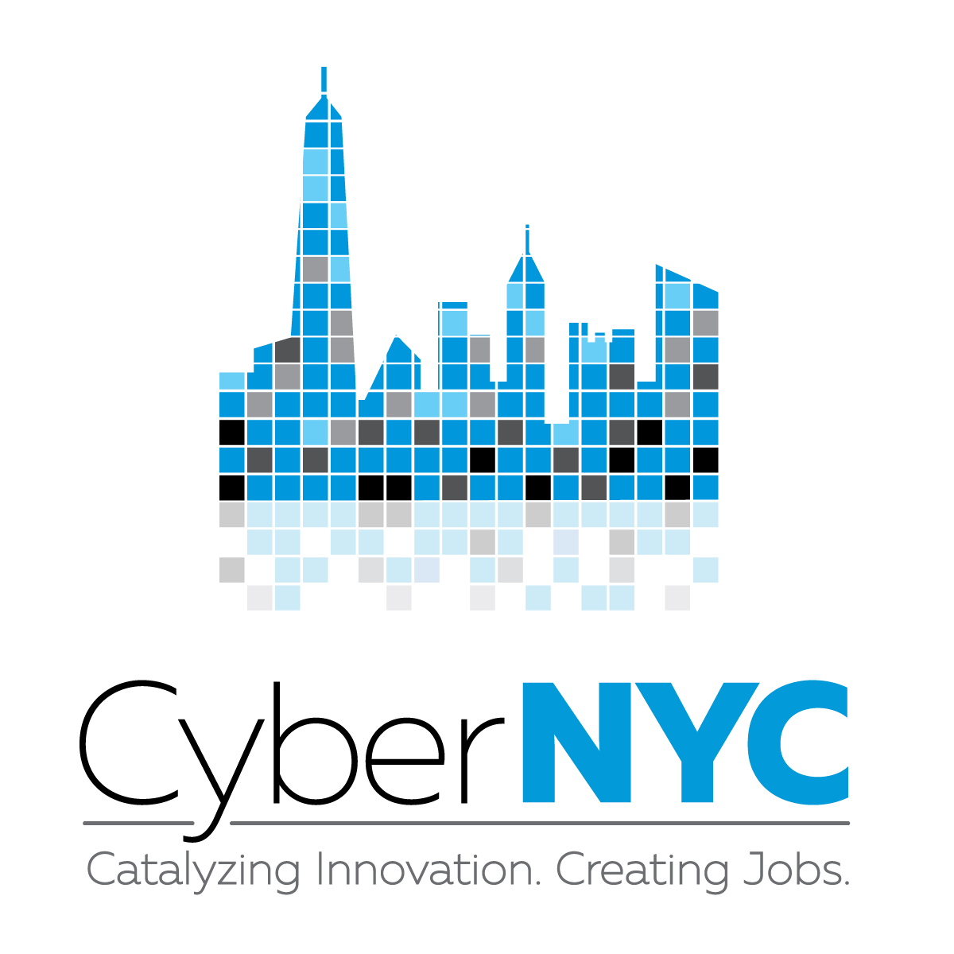





TIMELINE
1st Quarter
2nd Quarter
3rd Quarter
4th Quarter
Jan
Feb
Mar
Apr
May
Jun
Jul
Aug
Sep
Oct
Nov
Dec
ChatBot
Cybersecurity Videos
Live Chat
Revised Online Toolkit
Notes:
In the 1st quarter we were at the beginning stages of developing our company and ideas. Our team from two schools got together and signed up for InnoVention Society.
Currently in the 2nd quarter, we are developing a ChatBot, which would be able to answer our client's questions outside our normal hours of operation. We are also in contact with the NYC Economic Development Corporation and its Cyber NYC initiative. They are providing us with resources such as spreading the word about our company at their events and by connecting with them, we are also receiving introductions to other partnering organizations and companies.
For the 3rd quarter, we will launch our live help via a chat feature and resolve live help tickets. In addition to that, we will be working on developing an iOS and Android app.
In the 4th quarter, we are aiming to launch cybersecurity tutorial videos for our clients so they can learn about how to improve their cybersecurity posture. We are also planning to upload an even more revised toolkit online and make it an accessible with step-by-step guide for SBs seeking to implement security features on their own. Both of these are part of our scaling strategy to reach even more clients across the US.
Our goal for the 4th quarter is to work together with the NYC Department of Small Businesses, to get an even more direct access to our target group.

Slide 10




Cybersecurity
Clinic
SUMMARY
Every business, cyber protected
Problem
Solution
Product
Growth Strategy
Increased online business
SB are most suspectable
Data breaches can put SB out of business
Cybersecurity measures:
Prevention vs Remediation
Low-cost
Cybersecurity services:
Remote
Web services
ChatBot
Partnerships
Nationwide service delivery
App access
Questions/Comments?

